Slide 1
Lenovo issues
Park, Louis
Lead Software Engineer
June, 2014

Slide 2
Lenovo issues June 3rd
Lux and CCT performance under low light sources
Description : Error if the data used to build CCM matrix might be wrong because of the too small distance between the light sources and the detectors and dimmed incandescent light source. – see slide 3, 4, 5
Recommendation :
increase the measured distance
use a full incandescent light ( not dimmed ) if the light is dimmed
CCT error in driver source codes
Description: Error if outside of operating window (infinity) – see slide 6, 7, 8
Recommendation: have an exception handler in the driver
Lenovo will work the driver to move fast
In parallel, Intersil will work on it.
Recommendation of light source environment to measure
Description : from #1 issue, the environment should be modified
Recommendation : see slide 4
the Others – see slide 9

Slide 3
data analysis
left side data has over 140% CCT error.
it means the gathering data might be wrong
left side data present big different under incandescent light source.
it should suspect that the light was dimmed lights.
if you can measure CCT of dimmed incandescent lights, you should
use mean values from at least 6times RGB data. RGB data present
300ms so that it requires to mean during 300ms * 6 at least.

Slide 4
Recommendation of light source environment to measure
to get the right environment of Lux measurement, the environment should setup under geometrical optics.
too close to measure proper lux values, recommend to increase the distance between light sources and detectors.
the wall of the equipment should have non-reflective material. typically the color should be black.

Slide 5
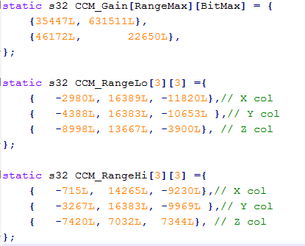
CCM Matrix
R | G | B | Range | Bit |  | X | Y | Z | x | y | n | Simple CCT
18581 | 18637 | 18638 | 10000 | 16 |  | 1744.4 | 1274.0 | 2816.9 | 0.299 | 0.218 | -1.0 | 16568.3
18581 | 18637 | 18638 | 375 | 16 |  | 839.8 | 712.2 | 418.4 | 0.426 | 0.361 | 0.5 | 2805.4
typically, given the same RGB values, both CCM_range result will go the similar xy- coordinate values. but, above table presents huge different xy-values and CCT values. it means the gathering data may be wrong.

Slide 6
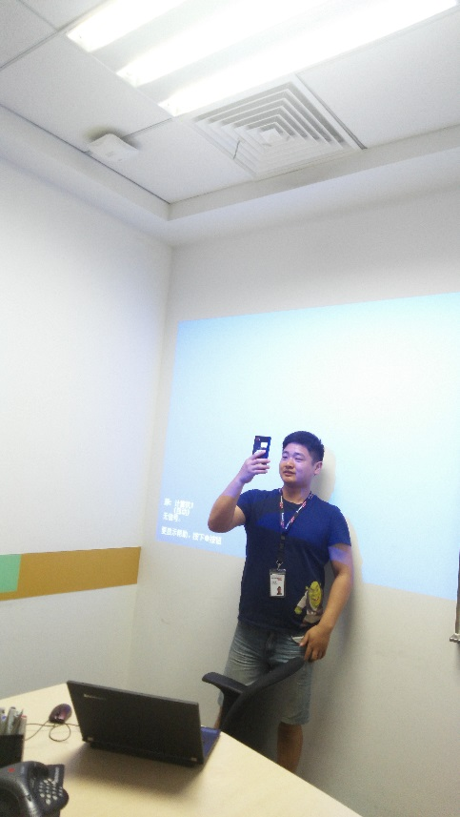
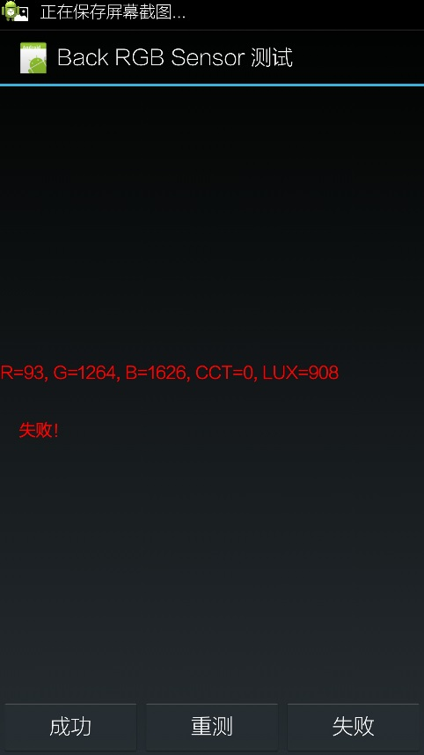
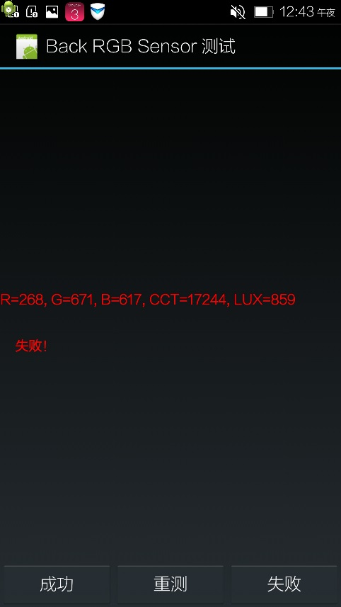
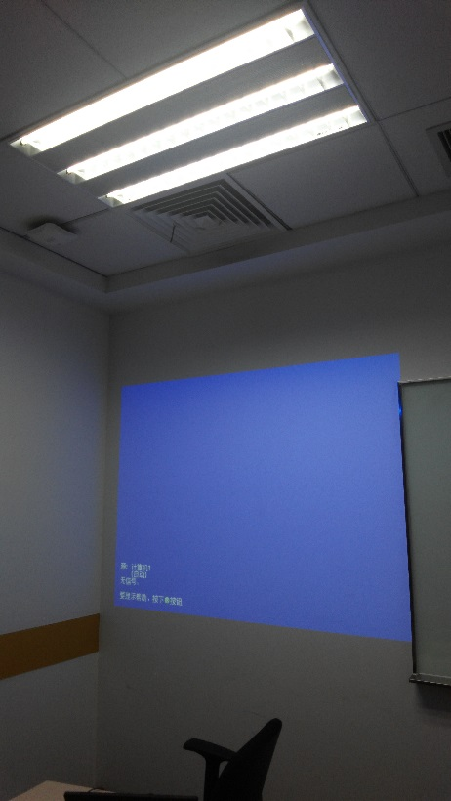
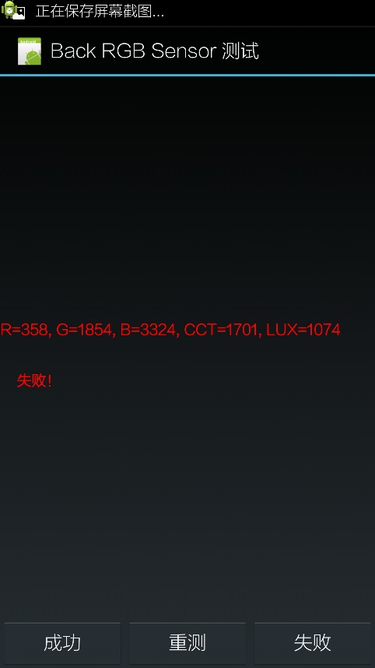
pictures of CCT error

Slide 7
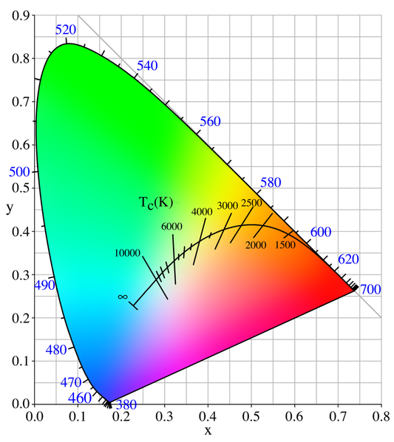
limitation of CCT
CCT value presents for measuring color temperature of white and is valid only the range from planckian locus.
you have to calculate CCT value at only left side inner rectangle area.
its area set around (0.25,0.45) ~ (0.545, 0.245).
Model No. | R | G | B | Range | Bit |  | X | Y | Z | x | y | n | Simple CCT
test | 93 | 1264 | 1626 | 375 | 16 |  | 34.39603 | 84.01980421 | 284.8442 | 0.0852949 | 0.208351406 | -10.939677 | 1089865.824

Slide 8
Projector Problem
Projector outputs blue rectangle light. CCT sensor cannot calculate blue light. only supporting xy-coordinate values.
and Projector consists of two kind. DLP and RGB. in case of DLP projector, CCT sensor has a problem due to higher light frequency than its rejection frequency. we have 50/60Hz flicker rejection. but DLP has 3~5 times 50/60Hz flicker light.

Slide 9
others
lux = cal_lux(dat, &cct, dbg)
if (lux > 80000) { lux = 3 * regr; }
if(regr==65535 && regg==65535 && regb ==65535) lux = 300000;
currently, your driver source codes have an exception handler for the CCT value at full scale range of RGB tri-stimulus values.
in facts, the exception handler has the below functions.
if when one of RGB tri-stimulus values goes to full scale range, then CCT calculation will go to exception and lux calculation will go to the eq quation of “lux eq = coef * G channel value”.
if when G channel value goes to full scale range and the current range is RangeRo, then the current range will go RangeHi and RGB tri-stimulus values should be reproduced.
if when G channel value goes to full scale range and the current range is RangeHi, then the lux value will go to satuaration.
if you want more increasing lux value then #3, you can use other channel values and make sure that it will include lux gain error and the equation is valid only with one light source like as sunlight.

